Slide 1




AD EXTENSION AUGMENTATION THROUGH LSTM-NLP SYNERGY: A DEEP LEARNING APPROACH
Date: 17/04/2024
Paper ID: ROBIN270
TEAM
M. Varshitha Reddy
N. Nikhitha

Slide 2



ABSTRACT
Online marketing heavily invests in ad extensions, a favored choice, directing budgets to precisely target audiences and entice engaged customers to interact with brand assets.
This model automates ad extension creation using real-time website data, NLP, LSTM, and sentiment analysis to boost ad effectiveness and campaign conversions for agencies.
In Ad Extensions, extensions leads to success

Slide 3

INTRODUCTION
Advertising agencies encounter substantial hurdles in securing pertinent ad extensions for clients, grappling with the arduous and time-consuming nature of the current approach. Furthermore, the evolving guidelines and fluctuations in client web content pose inherent risks in the selection of these extensions.

Slide 4

SOLUTION
Our model addresses the hurdles ad agencies face in elevating clickthrough and conversion rates using relevant ad extensions. Leveraging web scraping, NLP, data clustering, and LSTM, it crafts extensions and deploys via Django. By streamlining ad extension creation, the model aims to enhance visibility, engagement, and ultimately drive improved conversion rates.

Slide 5


SCOPE
The proposed automated ad extension system has broad applications in industries relying heavily on digital advertising like E-commerce, Retail, Education, Entertainment & Media, Technology, Hospitality & Travel, Finance, and more.

Slide 6
LITERATURE SURVEY
S.NO | TITLE | AUTHOR | YEAR | DESCRIPTION
1 | Keyword recommendation system for online advertising | Stamatina Thomaidou | 2011 | Query log mining method for effective keyword extraction but limited improvement in ad extensions for conversion rates.
2 | Comparison of printed and online advertisements | Matthias Baum | 2014 | Used Structural equation modeling for analyzing complex relationships among variables but it has more complexity, large sample sizes are needed for training
3 | Integrated framework for online ad campaign optimization | Liakopoulos Kyriakos | 2012 | Introduced Genetic algorithms, Google Adwords which is a comprehensive approach for campaign optimization and time-consuming approach for keyword selection.
4 | Online advertisement generation using Recurrent Neural Networks | Shauanfei Zhai | 2016 | Innovative attention network, mapping between queries and ads for relevance computation and it effects due to overfitting and scalability

Slide 7
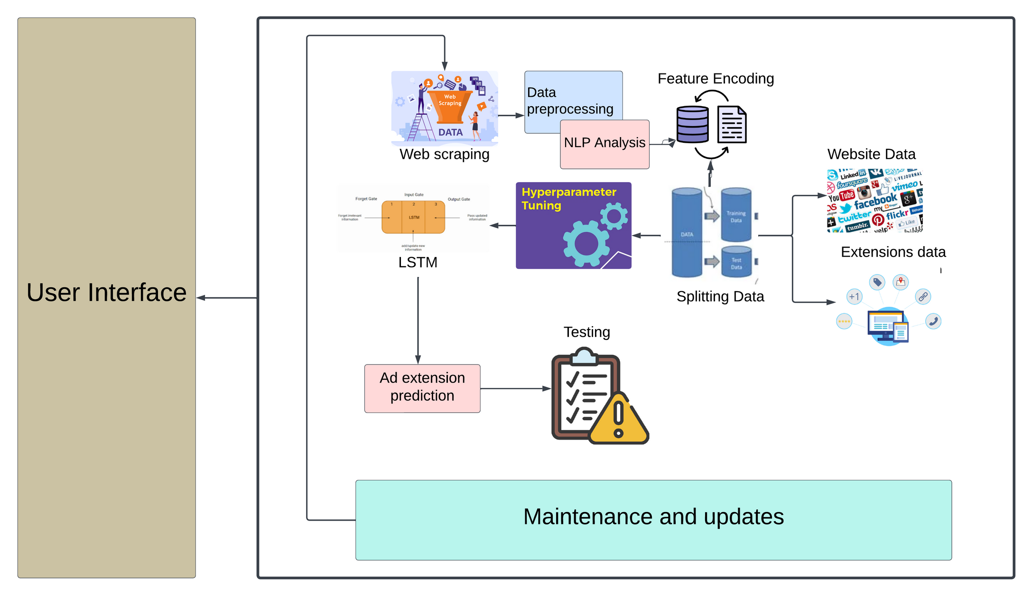
SYSTEM ARCHITECTURE

Slide 8
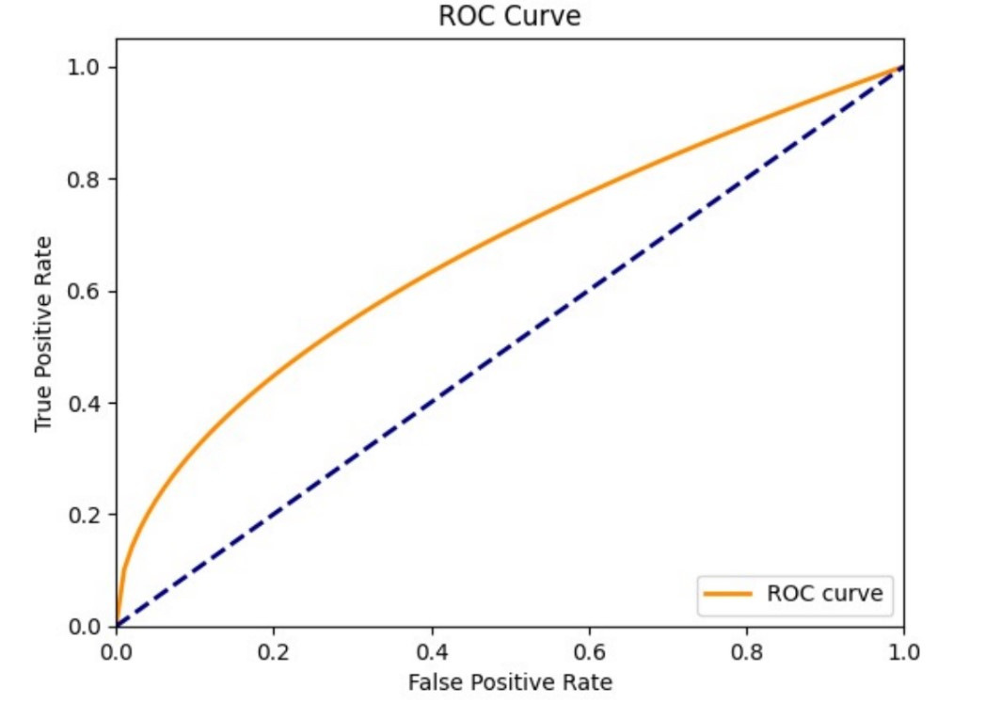
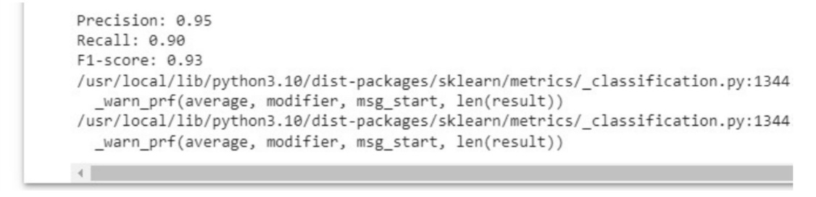
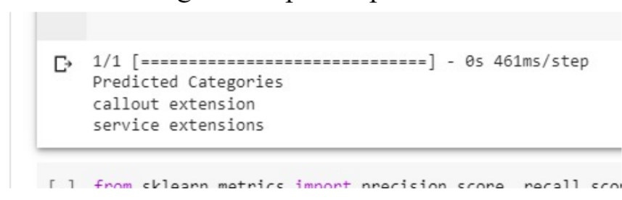
RESULTS

Slide 9
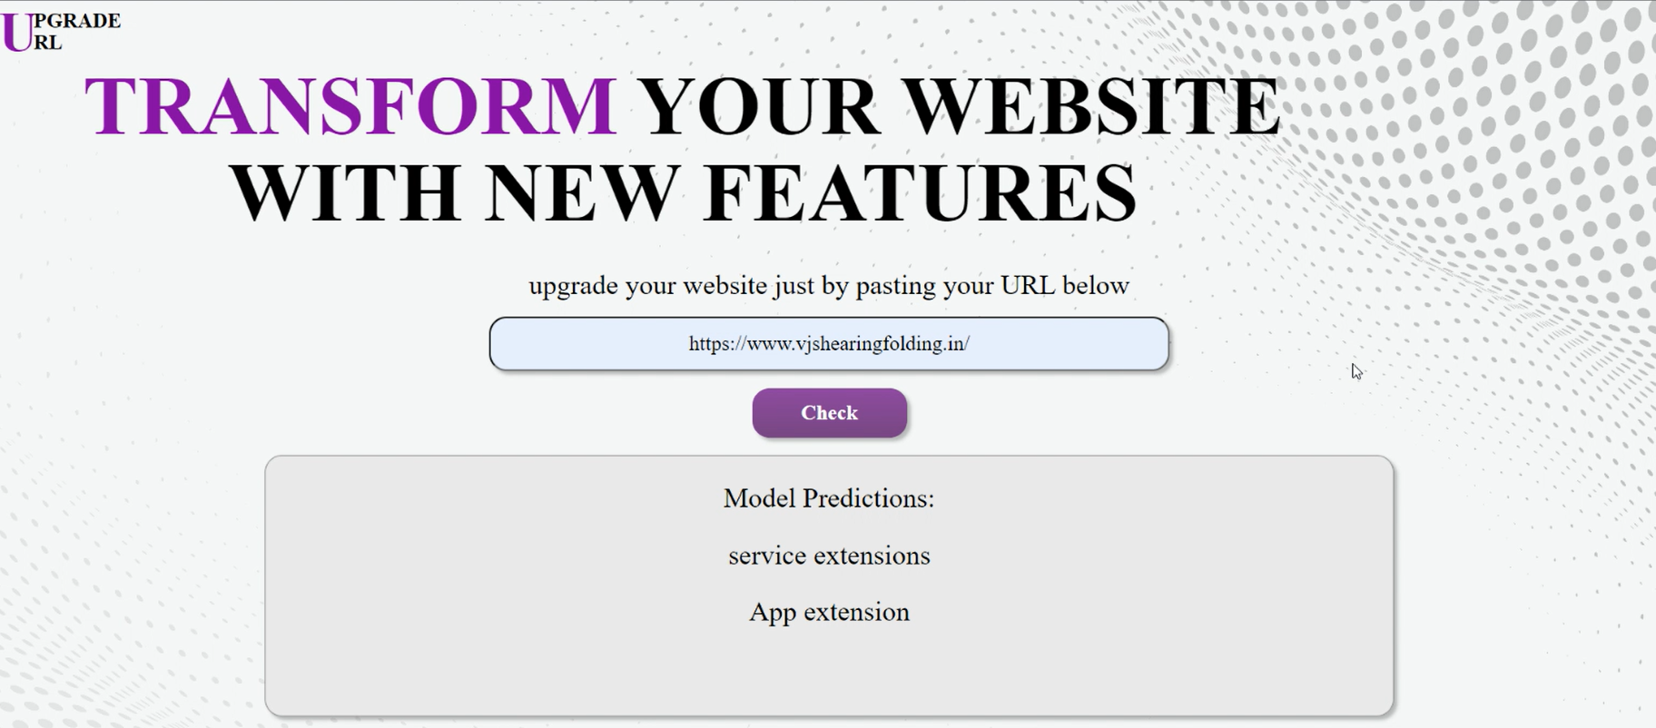

Slide 10
CONCLUSION
The ad extension project uses real-time data, advanced NLP, and LSTM networks to improve clickthrough rates and engagement. By integrating these tools, it keeps ad extensions updated with evolving website content without manual intervention. Incorporating sentiment analysis from customer reviews refines suggestions based on user preferences, potentially reshaping digital advertising.

Slide 11
FUTURE ENHANCEMENTS
Expanding insights beyond text to include images and videos could elevate the allure and engagement of ad extension recommendations.
MULTIMEDIA INTEGRATION
Adding multilingual support could extend the project's reach to a more diverse, global audience.
GLOBAL ACCESSIBILITY
Implementing dynamic personalization techniques could allow ad extensions to adapt in real-time based on user behavior
DYNAMIC PERSONALIZATION

Slide 12
REFERENCES
[1]ting-Ting Yang, Improving Discovery Process Toward User Engagement Based on Advertising Extensions in Bluetooth Low Energy Networks,”(IEEE Transactions on Mobile Computing),2022.
[2] Understanding the Ins Outs of Google Ad Extensions, SmartMedia.com, blog April 2022.
[3] Deliver more engaging Search ads with improvements to ad extensions, Google Blogspot, February 2022.
[4] Ad hoc cluster management for coverage extensions on high-frequency mobile backhaul network, International Conference on Information and Communication Technology Convergence(ICTC), 2020.
[5] James She and Pc Ng,” A compressive approach to detect the proximity between smartphones and BLE beacons,” IEEE Internet of Things Journal, vol 6, August 2019.
[6] Zhao Xu and MING JIN,” Determination of Design Extension Conditions List and Design Optimization of Safety Systems for ADS by Lines of Defenses Method,” IEEE, vol 6, September 2018.
[7]Piotr Lininski and authors,” Model of the Effectiveness of Google Adwords Advertising Activities”,IEEE International Computer Sciences and Information Technologies(CSIT), 2018.
[8] Reza Shokari, Amit Nayyeri,” Public Safety and AD hoc Networks: Coverage Extensions and Interoperability,” IEEE International Conference on Mobile Adhoc and Sensor systems(MASS), 2011.
[9] Sang Bae, Jae. h.Kim,” Performance Improvements of OSPF MANET Extensions: A Cross Layer Approach,” IEEE Military Communications Conference, 2007.
[10] Pavilhgo AltPntico em Lisboa, “Scalable multicast communications for ad hoc extensions attached to IP mobile networks,” 13th IEEE International Symposium on Personal,Indoor and Mobile Radio Communication(PIMRC), September 2002.

Slide 13
THANK YOU

